Slide 1

Elk Stack
Dima Ionut Daniel

Slide 2
Contents
What is Elk Stack ?
Goals
Components
Architecture
Core
Logstash
Elasticsearch
Kibana
Production
Conclussion
Bibliography

Slide 3

What is Elk Stack ?
ELK stack is a complete log analysis solution.
ELK stack components: Elasticsearch, Logstash and Kibana.
ELK stack is currently maintained and actively supported by the company called Elastic (formerly, Elasticsearch).

Slide 4
Goals
Log analysis is helpful for:
issue debugging
performance analysis
security analysis
predictive analysis

Slide 5
Components
Elasticsearch is a distributed open source engine based on Apache Lucene under Apache 2.0 license.
It provides horizontal scalability, reliability, and multitenant capability for real-time search.
Elasticsearch features are available through JSON over a RESTful API.
The searching capabilities are backed by a schema-less Apache Lucene Engine, which allows it to dynamically index data without knowing the structure beforehand.

Slide 6
Components (cont.)
Logstash is a data pipeline that helps collect, parse, and analyze a large variety of structured and unstructured data and events generated across various systems.
Features:
Centralized data processing
Support for custom log formats
Plugin development

Slide 7
Components (cont.)
Kibana is an open source Apache 2.0 licensed data visualization platform that helps in visualizing any kind of structured and unstructured data stored in Elasticsearch indexes.
It uses the powerful search and indexing capabilities of Elasticsearch exposed through its RESTful API to display powerful graphics for the end users.
Kibana makes it easy to understand large volumes of data.

Slide 8
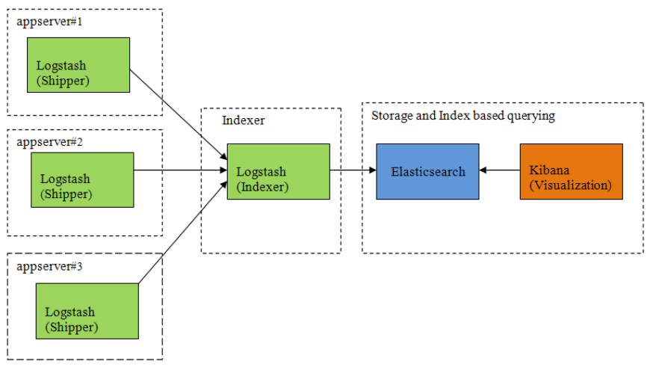
Architecture

Slide 9
Core
Logstash has a rich set of plugins for different types of inputs, outputs and filters, which can read, parse, and filter data.
A file input plugin streams events from the input file, and each event is assumed as a single line.
Automatically detects file rotation and handles it.
input {
file {
path => #String (path of the files) (required)
start_position => #String (optional, default "end")
tags => #array (optional)
type => #string (optional)
}
}

Slide 10
Core (cont.)
Once we configure the input file, we need to filter the input.
A filter plugin will perform the intermediary processing on the input event.
We have set up the data to be consumed by a CSV file into Logstash, followed by parsing and processing based on the data type needed
Now need to put the data in Elasticsearch so that we can index the different fields and consume them later via the Kibana interface.

Slide 11
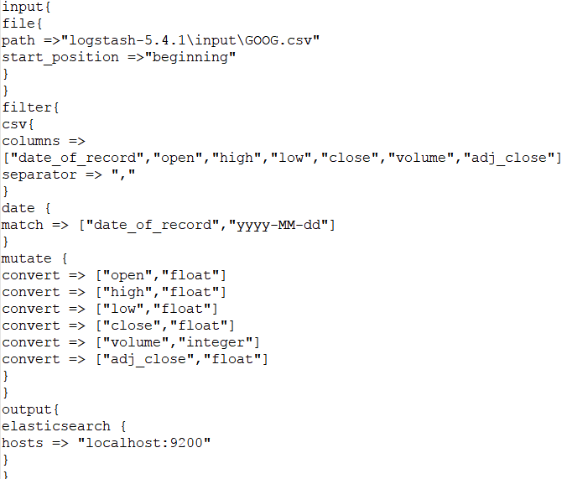
Core (cont.)

Slide 12
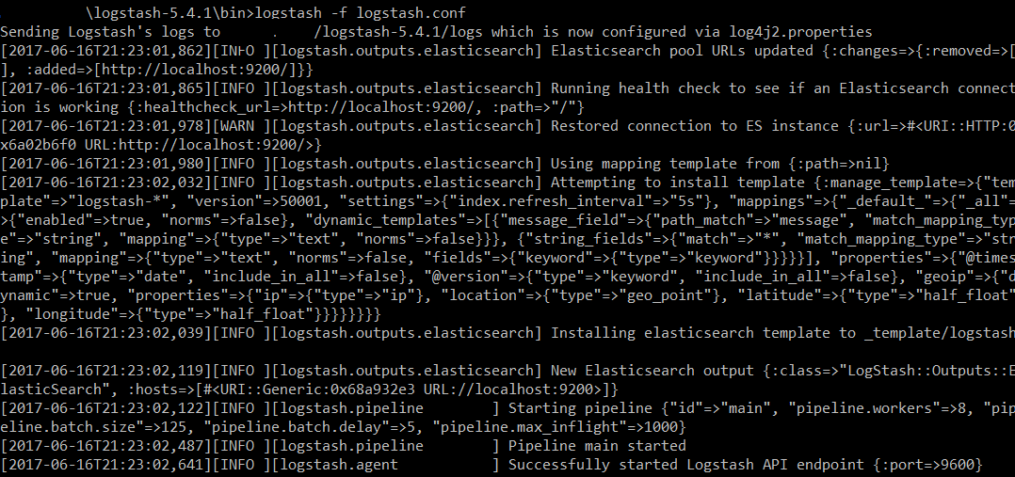
Core (cont.)
The saved configuration logstash.conf can be run using: bin/logstash –f logstash.conf

Slide 13
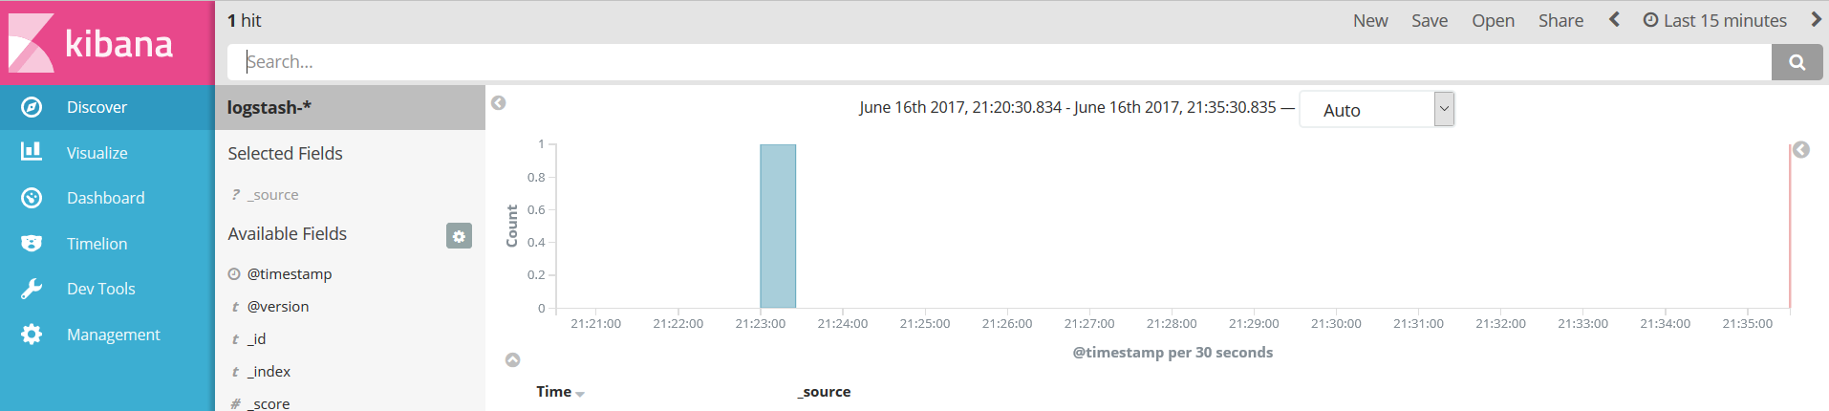
Core (cont.)
Using Kibana we can visualize the data stored by the Logstash.

Slide 14
Logstash
A Logstash configuration consists of a series of input, filter, and output plugins and their corresponding properties.
input {
}
filter {
}
output {
}

Slide 15
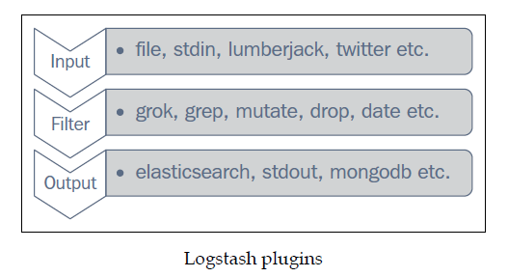
Logstash (cont.)
Each plugin plays an important role towards parsing, processing, and finally putting the data in the required format.
Input plugins generate the event, filters modify them, and output will deliver them to other systems.

Slide 16
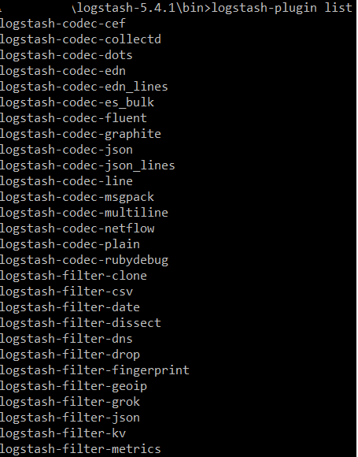
Logstash (cont.)
We can check the installed logstash plugins using: logstash-plugin list.

Slide 17
Logstash (cont.)
A Logstash plugin requires certain settings or properties to be set.
Those properties have certain values that belong to one of the following important data types.
An array is collection of values for a property.
A boolean value is either true or false (without quotes).
Codec is actually not a data type but a way to encode or decode data at input or output.
Hash is basically a key value pair collection.
String represents a sequence of characters enclosed in quotes.
Comments begin with the # character.

Slide 18
Logstash (cont.)
Fields can be referred to using [field_name] or nested fields using [level1][level2].
Logstash conditionals are used to filter events or log lines under certain conditions.
Logstash are handled like other programming languages and work with if, if else and else statements.
if <conditional expression1>{
#some statements here.
} else if <conditional expression2>{
#some statements here.
} else{
#some statements here.
}

Slide 19
Logstash (cont.)
Comparison operators include:
Equality operators: ==, !=, <, >, <=, >=
Regular expressions: =~, !~
Inclusion: in, not in
Boolean operators include and, or, nand, xor
Unary operators include !

Slide 20
Logstash (cont.)
Logstash type plugins:
Input
Filter
Output
Codec

Slide 21
Logstash (cont.)
An input plugin is used to configure a set of events to be fed to Logstash.
The file plugin is used to stream events and log lines files to Logstash.
It automatically detects file rotations, and reads from the point last read by it.
The Logstash file plugin maintains sincedb files to track the current positions in files being monitored.
By default it writes sincedb files at $HOME/.sincedb* path.
input{
file {
path => "/path/to/logfiles"
}
}

Slide 22
Logstash (cont.)
Configuration options
add_field: used to add a field to incoming events, its value type is Hash(default value is {}.)
add_field => { "input_time" => "%{@timestamp}" }
codec: used to specify a codec, which can decode a specific type of input.
delimiter: used to specify a delimiter, which identifies separate lines(default: "\n".)
exclude: exclude certain types of files from the input path, the data type is array.
path: specifies an array of path locations from where to read logs and events.

Slide 23
Logstash (cont.)
sincedb_path: specifies the location where to write the sincedb files, which keeps track of the current position of files being monitored.
sincedb_write_interval: specifies how often (number in seconds), the sincedb files that keep track of the current position of monitored files, are to be written.(Default 15 seconds)
start_position: It has two values: "beginning" and "end". It specifies where to start reading incoming files from. The default value is "end".

Slide 24
Logstash (cont.)
The type option is really helpful to process the different type of incoming streams using Logstash.
tags: specifies the array of tags that can be added to incoming events. Adding tags to your incoming events helps with processing later, when using conditionals.
If we specify "processed" in tags: tags =>["processed"]
In filter, we can check in conditionals:
filter { if "processed" in tags[]{} }

Slide 25
Logstash (cont.)
The stdin plugin is used to stream events and log lines from standard input.
Whatever we type in the console will go as input to the Logstash event pipeline.
The lumberjack plugin is useful to receive events via the lumberjack protocol that is used in Logstash forwarder.

Slide 26
Logstash (cont.)
Logstash provides a wide variety of output plugins that help integrate incoming events with almost any type of destination.
The email plugin is a very important output plugin as it is very useful to send e-mails for certain events and failure scenarios.
The csv plugin is used to write a CSV file as output, specifying the fields in csv and the path of the file.
The basic configuration of the csv output plugin looks like:
csv {
fields => ["date","open_price","close_price"]
path => "/path/to/file.csv"
}

Slide 27
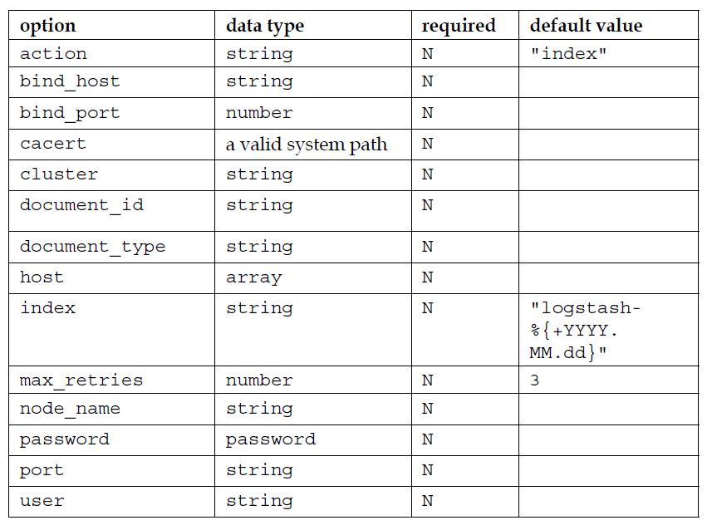
Logstash (cont.)
The elasticsearch plugin is the most important plugin used in ELK Stack, because it's where you will want to write your output to be stored to analyze later in Kibana.

Slide 28
Logstash (cont.)
Ganglia is a monitoring tool that is used to monitor the performance of a cluster of machines in a distributed computing environment.
Ganglia makes uses of a daemon called Gmond, which is a small service that is installed on each machine that needs to be monitored.
The ganglia output plugin in Logstash is used to send metrics to the gmond service based on events in logs.

Slide 29
Logstash (cont.)
The kafka output plugin is used to write certain events to a topic on kafka. It uses the Kafka Producer API to write messages to a topic on the broker.
The redis plugin is used to send events to a redis instance.
The rabbitmq plugin pushes the events from logs to the RabbitMQ exchange.
The stdout plugin writes the output events to the console.

Slide 30
Logstash (cont.)
Filter plugins are used to do intermediate processing on events read from an input plugin and before passing them as output via an output plugin.
The csv filter is used to parse the data from an incoming CSV file and assign values to fields.
The drop filter is used to drop everything that matches the conditionals for this filter.
The geoip filter is used to add the geographical location of the IP address present in the incoming event.
The mutate filter is an important filter plugin that helps rename, remove, replace, and modify fields in an incoming event.

Slide 31
Logstash (cont.)
Codec plugins are used to encode or decode incoming or outgoing events from Logstash acting as stream filters in input and output plugins.
Important codec plugins are:
avro
json
line
multiline
plain
rubydebug
spool

Slide 32
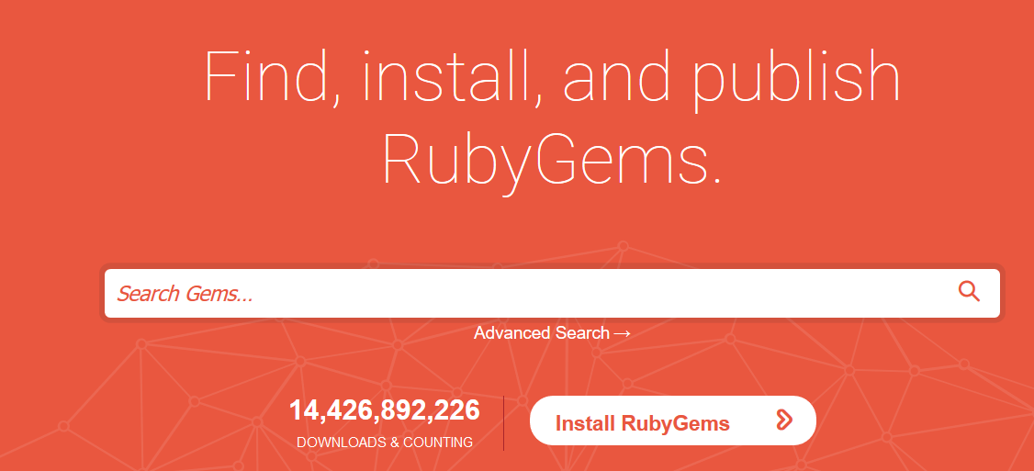
Logstash (cont.)
Logstash plugin management is done through the install script that is shipped with the Logstash installation: $LOGSTASH_HOME/bin/logstash-plugin.
To install a plugin, we can use the command: $bin/logstash-plugin install <plug_in_name>.
plug_in_name is the name of the plugin as mentioned in the gem name in https://rubygems.org/ or in the Logstash plugin repository.

Slide 33
Logstash (cont.)
To update a previously installed plugin, we can issue the command: $bin/logstash-plugin update <plug_in_name>.
To uninstall a plugin, we can issue the following command: $bin/logstash-plugin uninstall <plug_in_name>.
Logstash plugins are selfcontained RubyGems.

Slide 34
Elasticsearch
Elasticsearch is a search and analytics engine that enables fast and scalable searches in a distributed environment.
Elasticsearch is built on Apache Lucene.
Elasticsearch hides the complexity behind Lucene by providing a powerful RESTful API built on top of it.

Slide 35
Elasticsearch (cont.)
Index in Elasticsearch is a collection of documents that share some common characteristics.
Each index contains multiple types, which in turn contains multiple documents, and each document contains multiple fields.
An index consists of multiple JSON documents in Elasticsearch.
There can be any number of indices in a cluster in Elasticsearch.

Slide 36
Elasticsearch (cont.)
In ELK, when Logstash JSON documents are sent to Elasticsearch, they are sent as the default index pattern "logstash-%{+YYYY.MM.dd}".
It partitions indices by day so that it can easily be searched and deleted if required.
This pattern can be changed in the Logstash output plugin configuration.
The URL to search and query the indices looks like this:
http://localhost:9200/[index]/[type]/[operation]

Slide 37
Elasticsearch (cont.)
A document in Elasticsearch is a JSON document stored in an index.
Each document has a type and corresponding ID, which represents it uniquely.
A document stored in Elasticsearch would look similar to this:
{
"_index" : "packtpub",
"_type" : "elk",
"_id" : "1",
"_version" : 1,
"found" : true,
"_source":{
book_name : "learning elk"
}
}

Slide 38
Elasticsearch (cont.)
A field is a basic unit inside a document.
Type is used to provide a logical partition inside the indices.
An index can have multiple types and we can define them as per the context.
Mapping is used to map each field of the document with its corresponding data type, such as string, integer, float, double, date, etc.
Elasticsearch creates a mapping for the fields automatically during index creation, and those mappings can be easily queried or modified based on specific types of needs.

Slide 39
Elasticsearch (cont.)
A shard is the actual physical entity where the data for each index is stored.
Each index can have a number of primary and replica shards where it stores the data.
Shards are distributed among all the nodes in the cluster and can be moved from one node to another in case of node failures or the addition of new nodes.

Slide 40
Elasticsearch (cont.)
Each document in an Elasticsearch index is stored on one primary shard and a number of replica shards.
While indexing, the document is first stored on a primary shard and then on the corresponding replica shard.
By default, the number of primary shards for each index is 5.
Replica shards will typically reside on a different node than the primary shard and help in case of failover and load balancing to cater to multiple requests.

Slide 41
Elasticsearch (cont.)
A cluster is a collection of nodes that stores the indexed data.
Elasticsearch provides horizontal scalability with the help of data stored in the cluster.
Each cluster is represented by a cluster name, which different nodes join.
A node is a single running instance of Elasticsearch, which belongs to one of the clusters.
By default, every node in Elasticsearch joins the cluster named "elasticsearch".

Slide 42
Elasticsearch (cont.)
We can see all available indices in our cluster by executing the following command: curl –XGET 'localhost:9200/_cat/indices?v'.
We can see all nodes in a cluster by invoking the following command: curl –XGET 'http://localhost:9200/_cat/nodes?v'.
We can check the health of a cluster by invoking the following command: curl –XGET 'http://localhost:9200/_cluster/health?pretty=true'.

Slide 43
Elasticsearch (cont.)
Elasticsearch cluster health is indicated in three parameters:
Red indicates that some or all primary shards are not ready to serve the requests.
Yellow indicates that all primary shards are allocated but some or all of the replicas have not been allocated. Normally, single node clusters will have their health status as yellow as no other node is available for replication.
Green indicates that all shards and their replicas are well allocated and the cluster is fully operational.

Slide 44
Kibana
Kibana makes it easy to create and share dashboards consisting of various types of charts and graphs.
Kibana visualizations automatically display changes in data over time based on Elasticsearch queries.

Slide 45
Kibana (cont.)
A Kibana interface consists of 6 main tabs:
Discover: The Discover page enables free text searches, field-based searches, range-based searches, and so on.
Visualize: The Visualize page enables building many visualizations, such as pie charts, bar charts, line charts, and so on, which can be saved and used in dashboards later.
Dashboard: The Dashboard represents collections of multiple visualizations and searches, which can be used to easily apply filters based on click interaction, and draw conclusions based on multiple data aggregations.
Timelion: time series composer
DevTools: hold multiple dev facing apps with console
Settings: Settings enables the configuration of index patterns, scripted fields, the data types of fields, and so on.

Slide 46
Production
ELK Stack can be used in production with huge amounts of data and a variety of data sources.
Perquisites are:
Prevention of data loss
Data protection
Scalability of the solution
Data retention

Slide 47
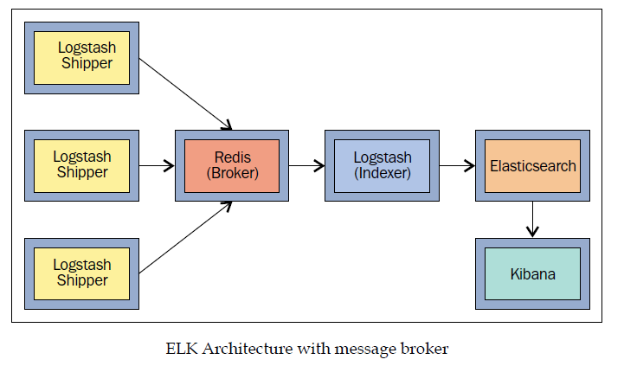
Production (cont.)
Data loss prevention is critical for a production system.
Data loss can be prevented using a message broker in front of the Logstash indexers.
Message brokers, such as Redis, prove to be useful when dealing with a large stream of data, as Logstash may slow down while indexing data to Elasticsearch.

Slide 48
Production (cont.)
Since data is of immense value and carries a lot of confidential information, it is extremely important to protect the data at various points while in ELK Stack.
Elasticsearch indices must be prevented from unauthorized access, and Kibana Dashboard should be protected too.
Kibana supports SSL encryption for both client requests and the requests the Kibana server sends to Elasticsearch.

Slide 49
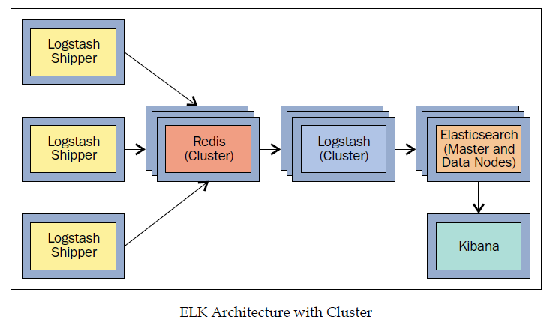
Production (cont.)
As the data in the application grows, it's essential that the log analytics system should scale.
There are times when your systems are under a heavy load, and you need your log analytics systems to analyze what is going on with the application.

Slide 50
Conclusion
ELK is great to use because the tools are built by people with a lot of experience it has a great community and lots of documentation.

Slide 51

Bibliography
https://www.elastic.co/webinars/introduction-elk-stack
Packt Pub – Learning ELK Stack

Slide 52
Questions ?

